Slide 1
Concrete Crack detection Using Convolutional Neural Networks
Using Deep Learning Models
UTKARSH ANAND (20CE8047, B. Tech Civil Engineering)
under guidance of
GILBERT HINGE(Assistant Professor , Civil Engineering)

Slide 2
Contents
Importance of Crack Detection using Deep Learning
Objective
Surface Crack Detection Dataset
Work Flowchart
Model 1: ResNet-50 with Segmentation
Model 2: YOLOv8 model
Results
Conclusion
References

Slide 3
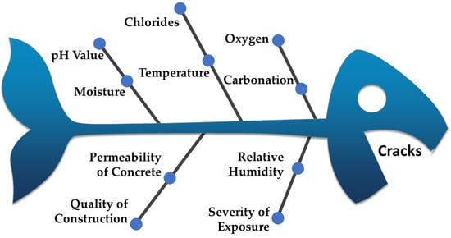
Introduction
Cracks in concrete structures are a common phenomenon associated with corrosion, chemical deterioration, and the application of adverse loading.
The appearance of these cracks is a sign of stress, weakness, and wear and tear within the structure, leading to possible failure/collapse.
The significance of a crack depends on its length, width, depth, and location.
Therefore, monitoring the structural health, reliability, and performance is essential for the long-term serviceability of the infrastructure
Source: Vaughn et al.(2022)

Slide 4
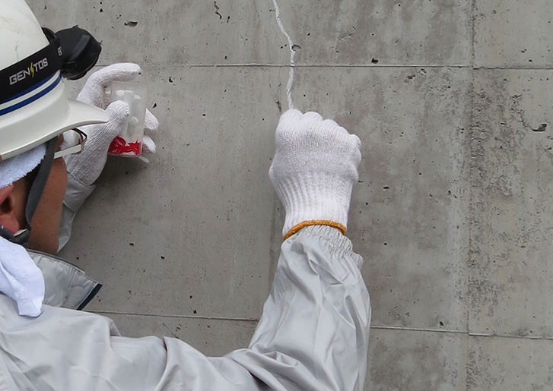
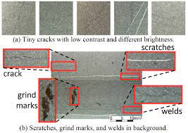
Role of CNN for Crack Detection
Manual Inspection
Time Consuming
Costly
Skill Required
Subjectivity
Automated Inspection
Reduces Cost
Reduces Time
Less Biased
More Effective

Slide 5
Objective
To develop and compare various Convolutional Neural Network Models for multi label crack detection
To determine which models are best effective for crack detection in various scenarios namely static and dynamic object detection

Slide 6
About the Dataset
Source :https://www.kaggle.com/datasets/arunrk7/surface-crack-detection
The datasets contains images of various concrete surfaces with and without crack
.Each class has 20000images with a total of 40000 images with 227 x 227 pixels with RGB channels. The dataset is generated from 458 high-resolution images (4032x3024 pixel) with the method proposed by Zhang et al (2016).
High resolution images found out to have high variance in terms of surface finish and illumination condition.
No data augmentation in terms of random rotation or flipping or tilting is applied.

Slide 7

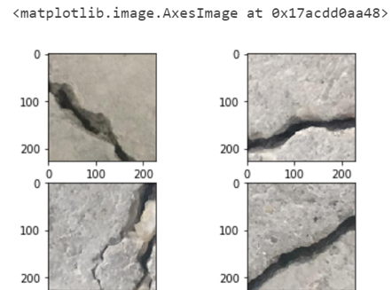
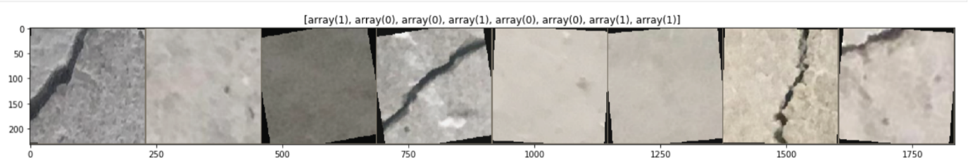
Sample Images From the Dataset
A)Random images from Dataset in Grid form
B)First 8 images from Dataset in Array form

Slide 8
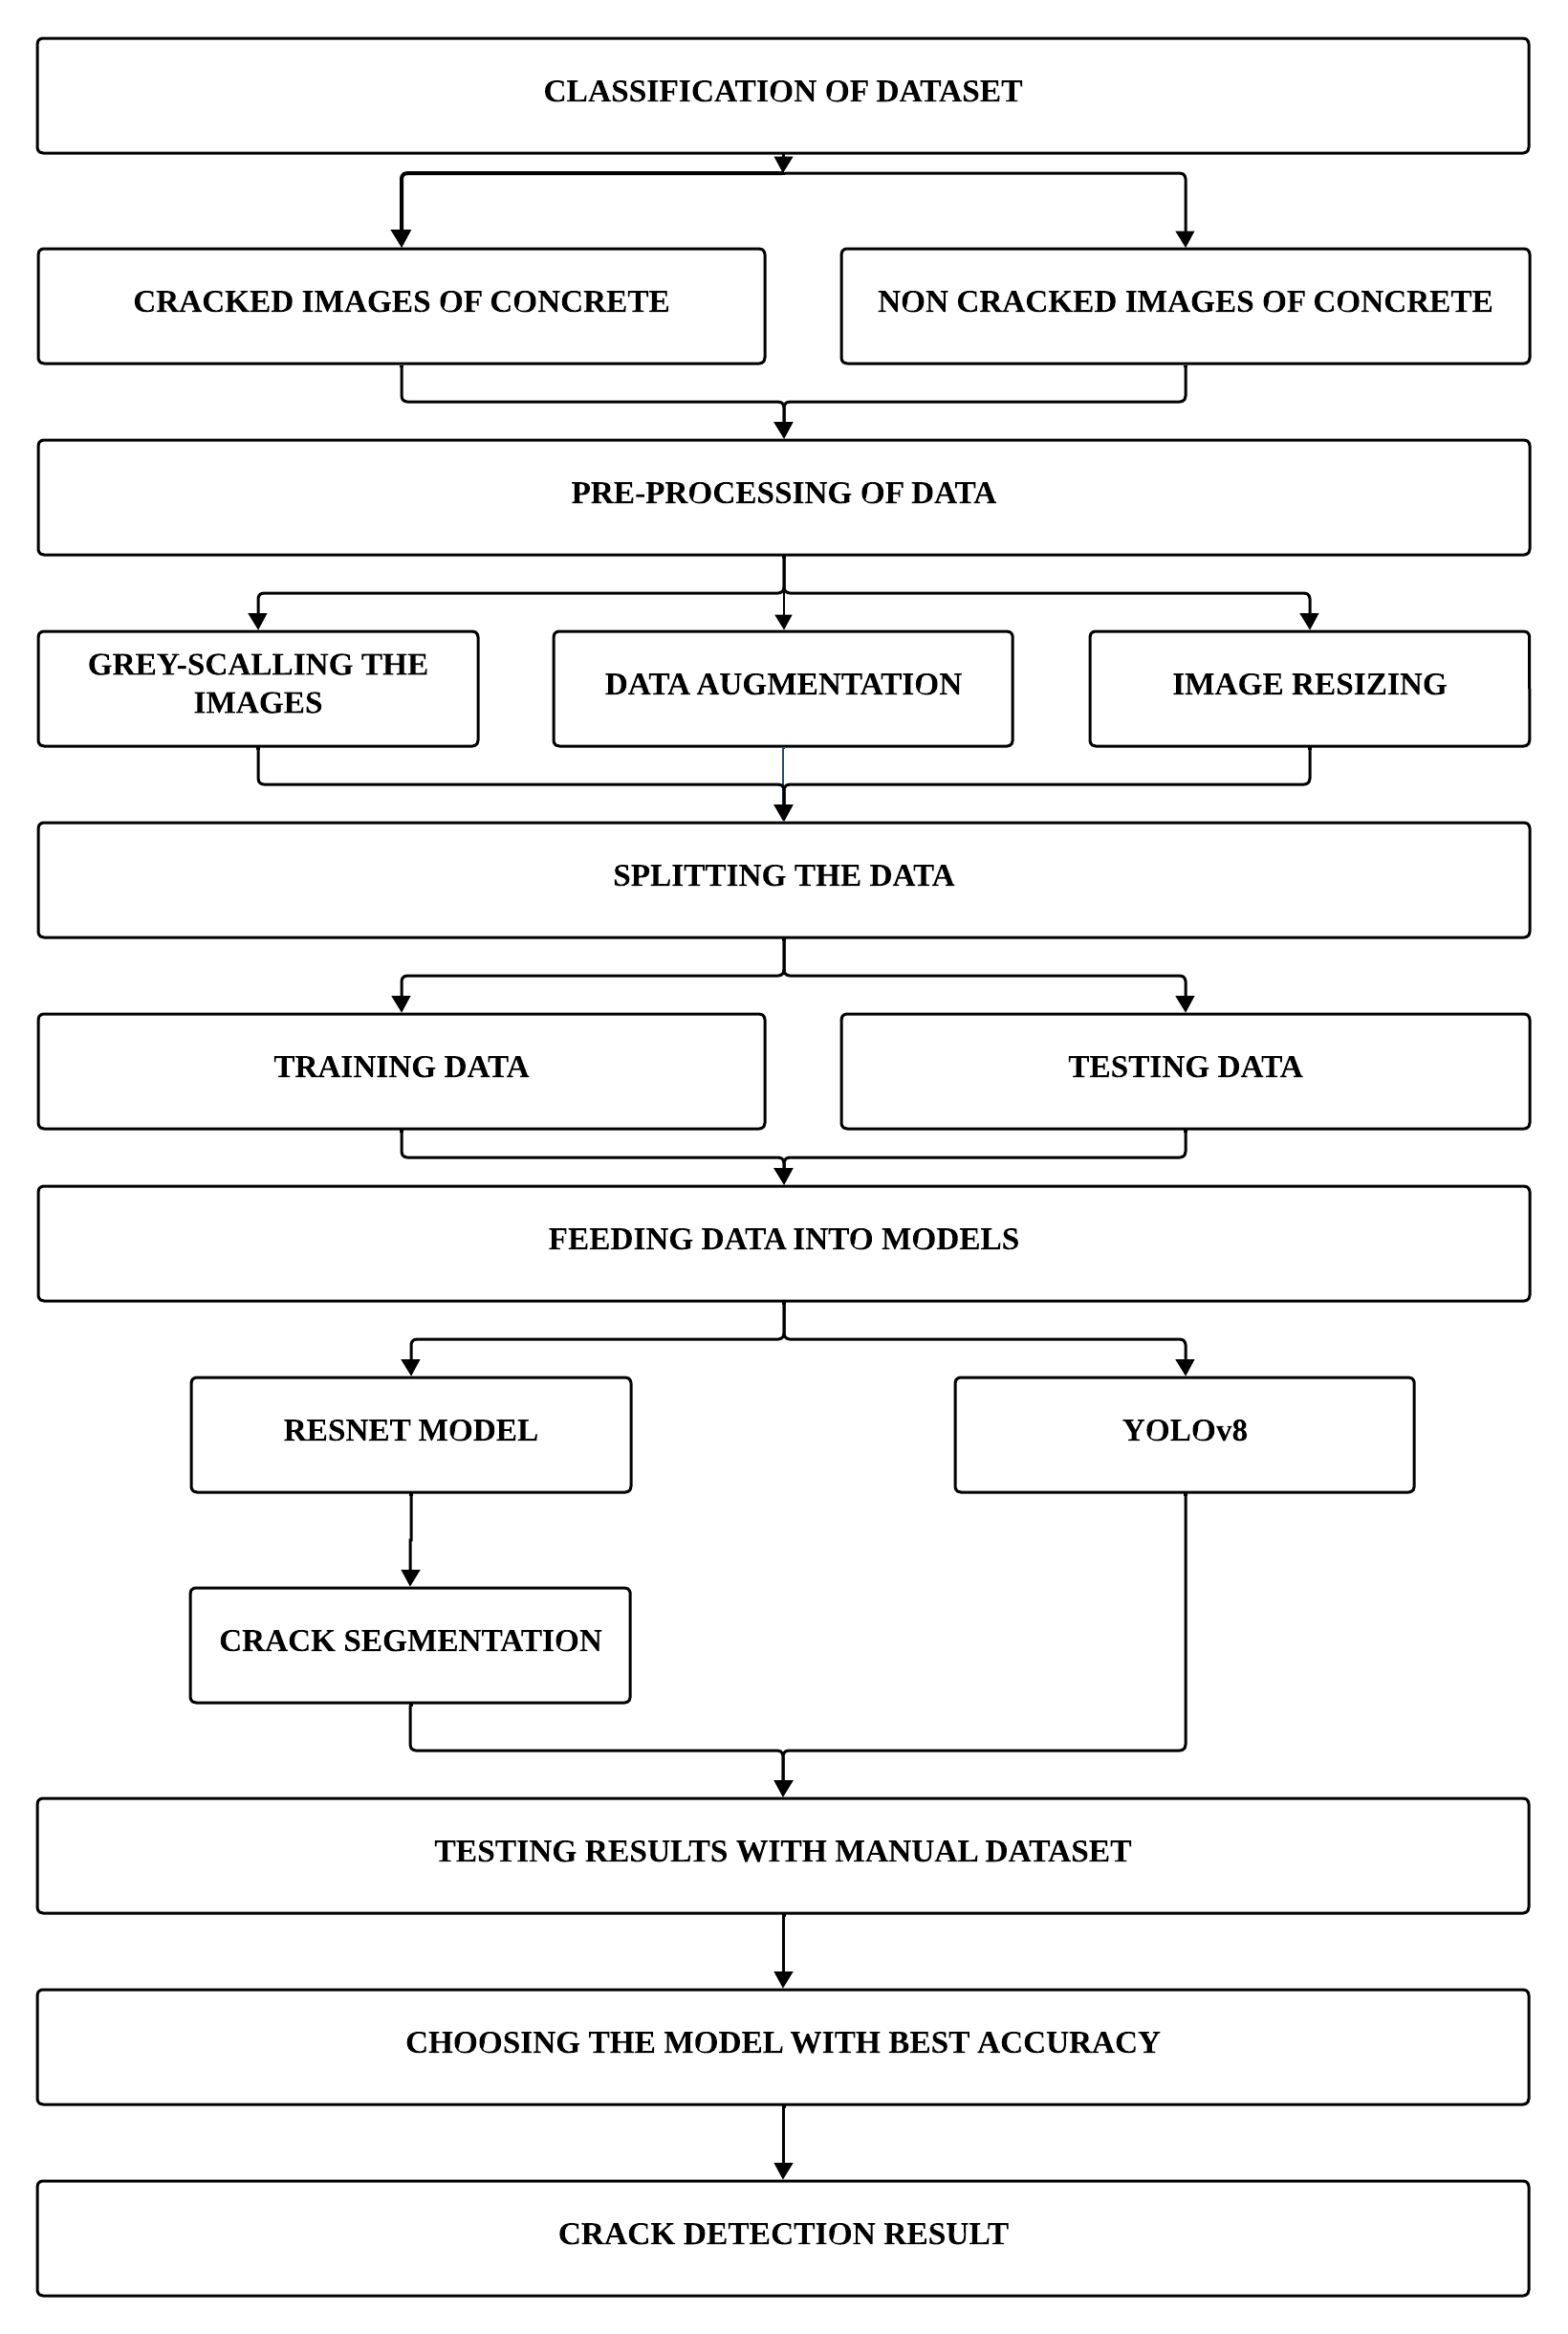

Slide 9
Data Augmentation
Importance of Data Augmentation: Data augmentation is crucial for preparing datasets for training deep learning models.
Purpose of Data Augmentation: This process involves introducing variations to the original images, enriching the dataset, and improving the model's ability to generalize to unseen data.
Role in Crack Detection: In the context of crack detection, data augmentation plays a significant role.
Enhancing Robustness and Diversity: It enhances the robustness and diversity of the training set, which is essential for training accurate and reliable crack detection models.

Slide 10
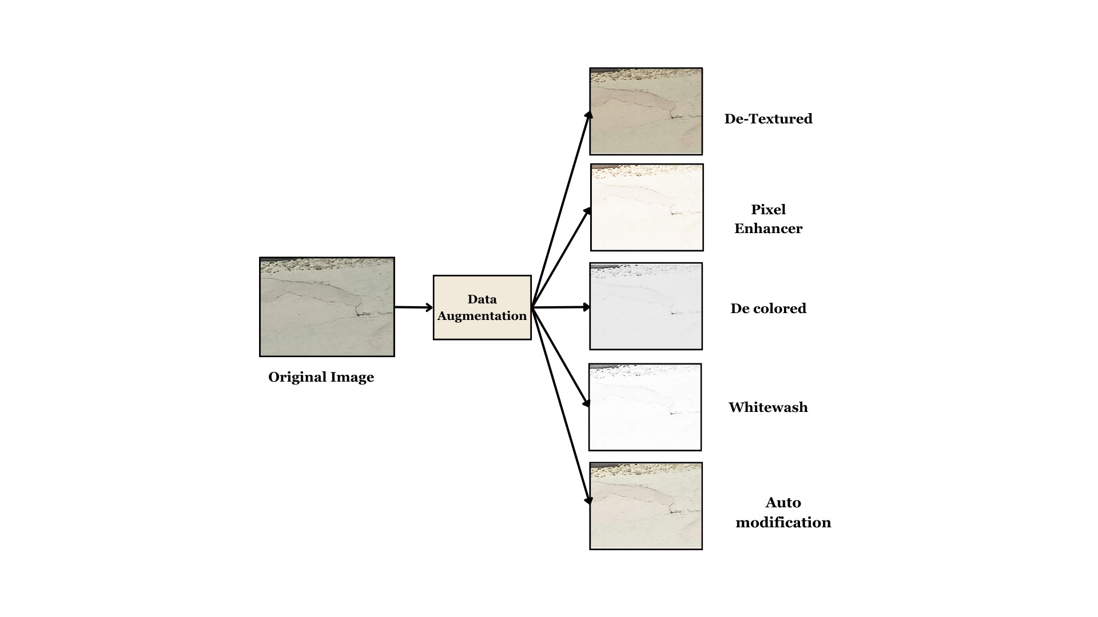

Slide 11
Model 1: ResNet-50 with Segmentation
ResNet-50 Architecture: ResNet-50 is known for its deep layers and exceptional performance in various tasks.
Integration with Segmentation Techniques: Researchers have integrated segmentation techniques into ResNet-50-based models for crack detection.
Purpose of Segmentation: Segmentation allows for more granular localization of cracks within an image.
Impact on Crack Detection Precision: This integration of segmentation model contributes to enhanced precision in crack detection by improving accuracy in identifying crack boundaries.

Slide 12
Data Loader Component
Purpose of Load Dataset Function: The load dataset function incorporates chosen transformations into the data loading process.
Augmented Data for Training: It provides models with augmented data, enhancing the dataset's diversity and improving the model's ability to generalize.
Balancing Realism and Efficiency: This approach balances the realism introduced by data augmentation with computational efficiency during the training phase.

Slide 13
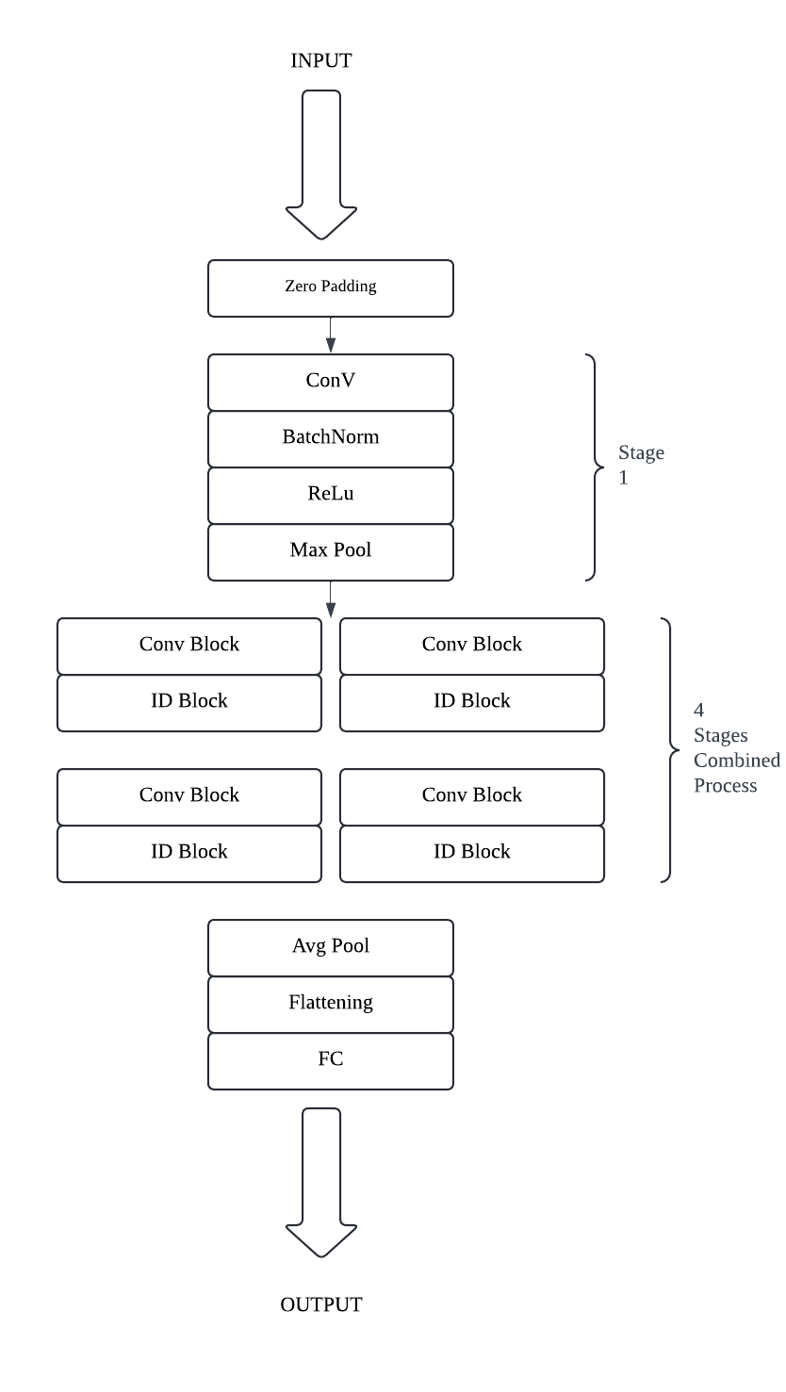
Model Architecture
ResNet-50

Slide 14
Why ResNet Models
ResNet Models Preferred: ResNet models, particularly ResNet50 and its variants, are preferred in deep learning tasks.
Deeper Architectures with Skip Connections: They are favored due to their deeper architectures with skip connections.
Mitigating Vanishing Gradient Problem: These skip connections help mitigate the vanishing gradient problem, which is crucial for effectively training very deep networks.
Better Feature Learning: The architecture promotes better feature learning, leading to improved model performance.
Popular in Computer Vision Tasks: ResNet models, because of their advantages, are popular choices for various computer vision tasks such as image classification, object detection, and segmentation

Slide 15
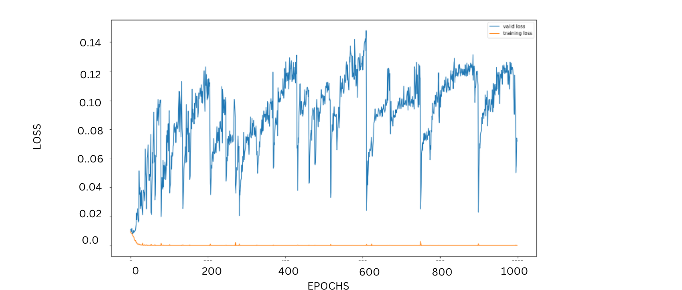
Loss vs Epochs

Slide 16
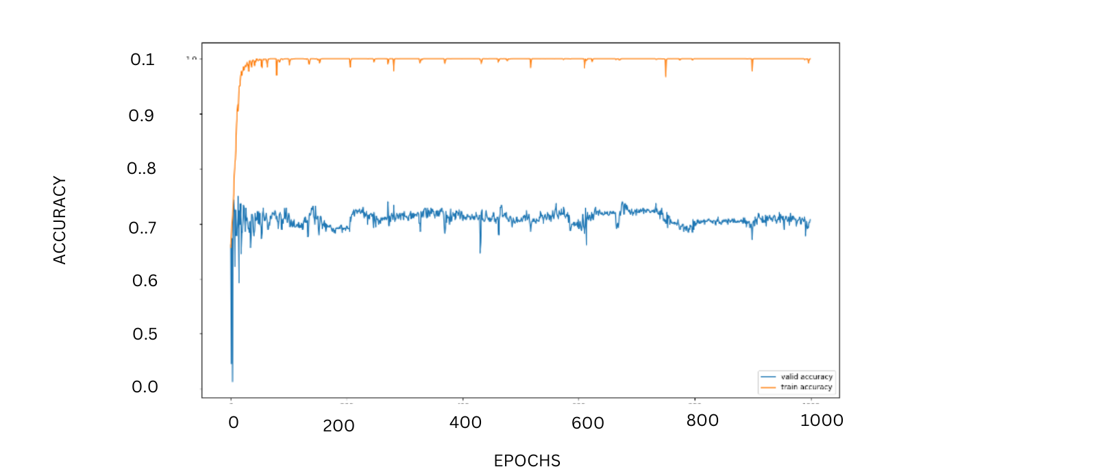
Accuracy vs Epochs

Slide 17
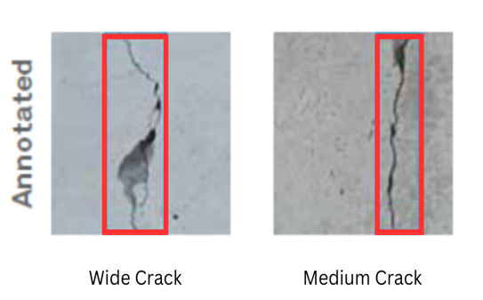
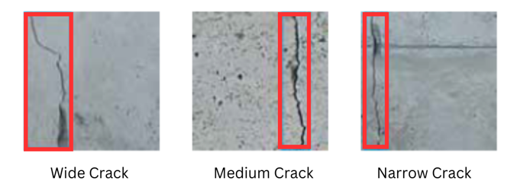
Multi-Label Classification using Segmentation

Slide 18
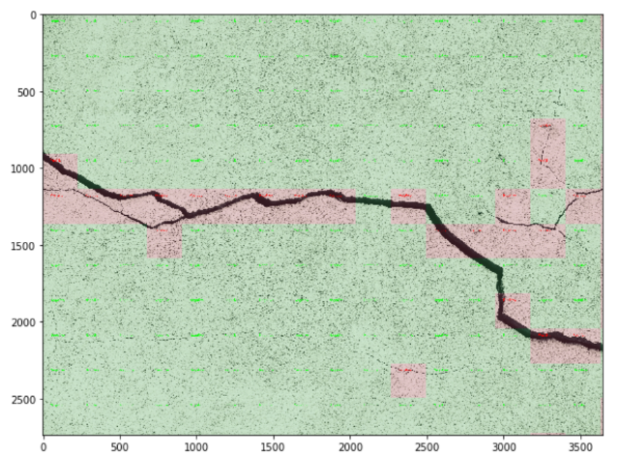
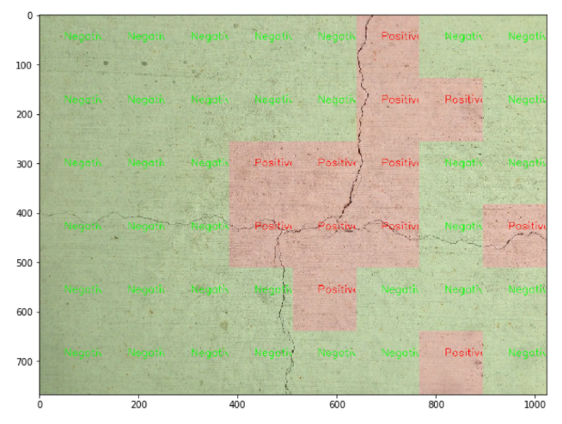
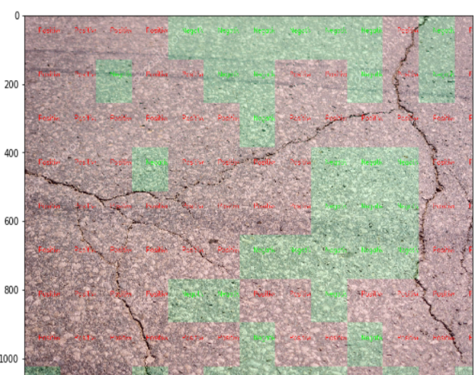
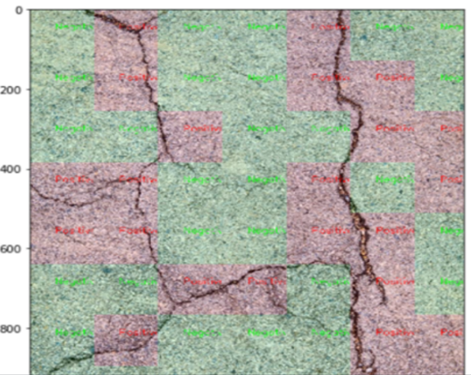
ResNet-50 Model Results with Color Segmentation

Slide 19
Testing of Model with Self Clicked Images of Cracks in Hall-1

Slide 20
Model 2: YOLOv8 model
YOLO Series and YOLOv8: The You Only Look Once (YOLO) series, especially YOLOv8, is renowned for its real-time object detection capabilities.
Robust Framework for Crack Detection: YOLOv8 excels in crack detection as a robust framework for binary classification, efficiently identifying the presence or absence of cracks within an image.
Real-time Processing: The model's ability to simultaneously process the entire image and make predictions in real-time is a significant advantage.
Swift Detection for Imperative Applications: This swift detection capability is crucial for applications where swift detection is imperative.
Optimized Loss Functions and Data Augmentation: YOLOv8 uses the most optimized loss functions and data augmentation techniques, resulting in very high accuracy in its results

Slide 21
Network Architecture
YOLOv8 employs a deep neural network architecture, typically based on a backbone like CSPDarknet53 or YOLOv4's CSPNet, which extracts features from the input image. The network is designed to capture hierarchical features at different scales. Basically, imported form ultralytics library which is free to use

Slide 22
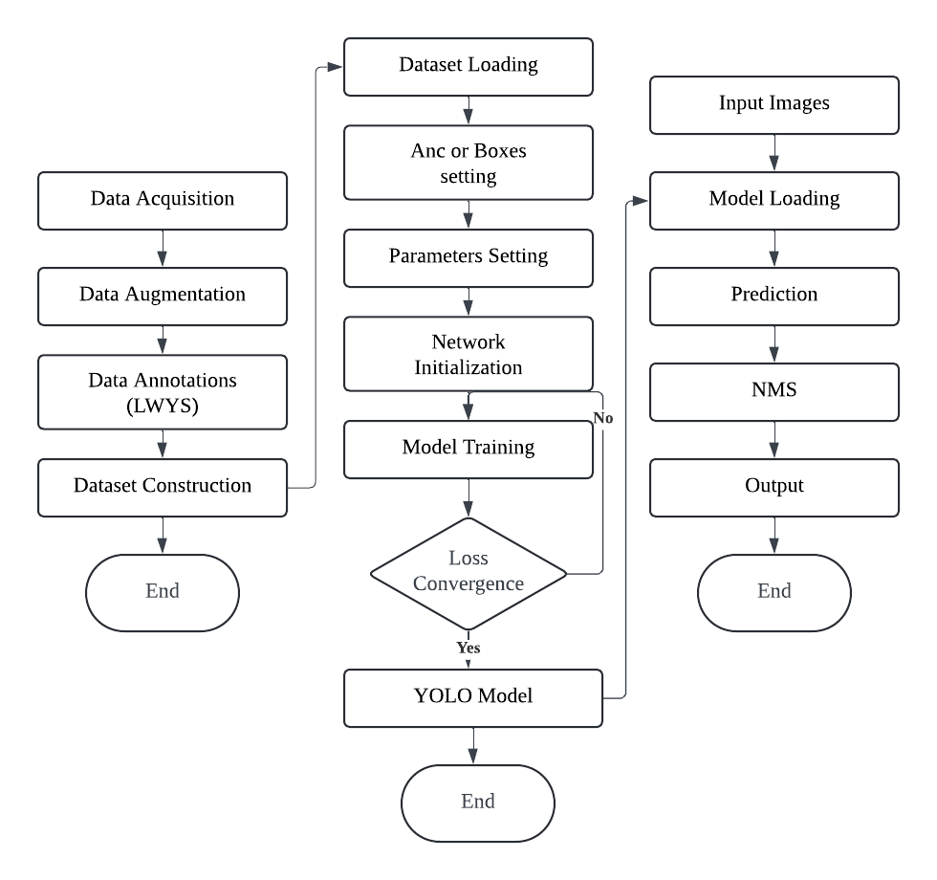
YOLOv8 Model Architecture

Slide 23
Object Classification
YOLOv8's architecture includes a classification head that is responsible for predicting the class of the detected object. Each bounding box is associated with a confidence score (indicating the likelihood of the object's presence) and a class probability distribution (indicating the likelihood of the object belonging to each class).

Slide 24

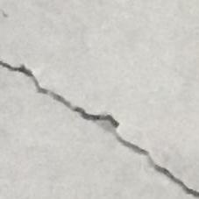
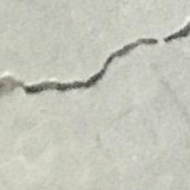

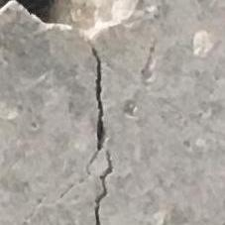
Negative Positive Positive
Binary Classification
Result For YOLOv8
Negative Positive

Slide 25
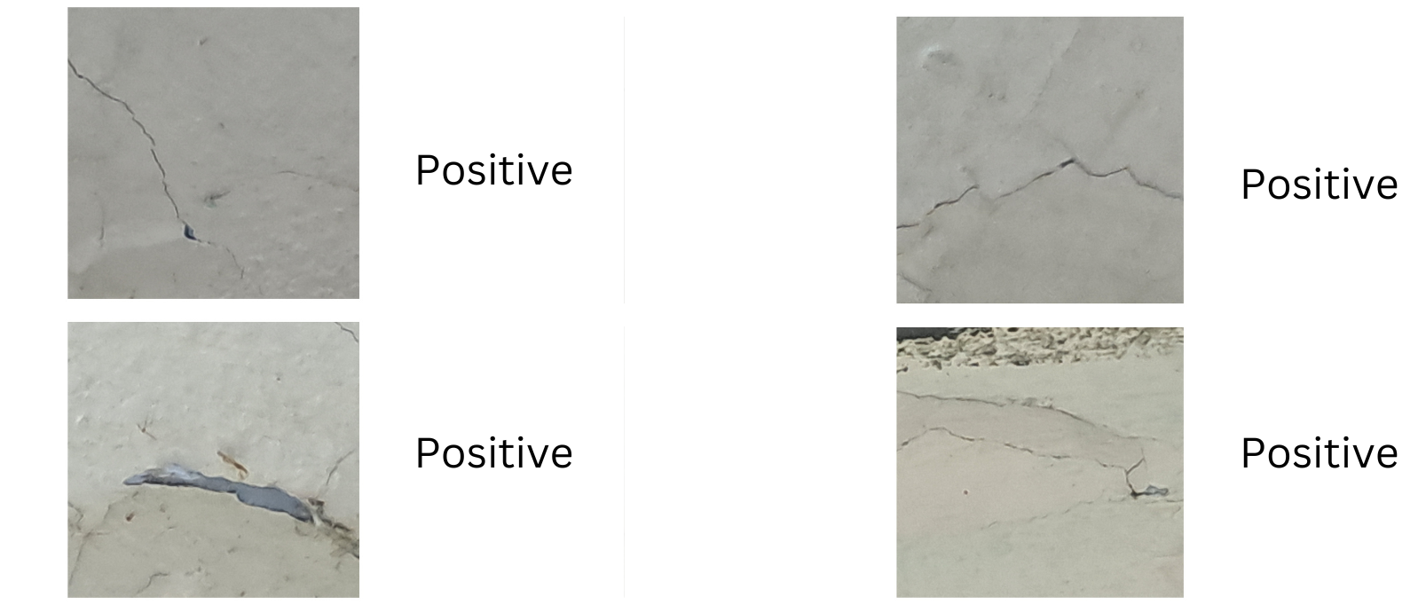
Testing of Model with Self Clicked Images of Cracks in Hall-1

Slide 26
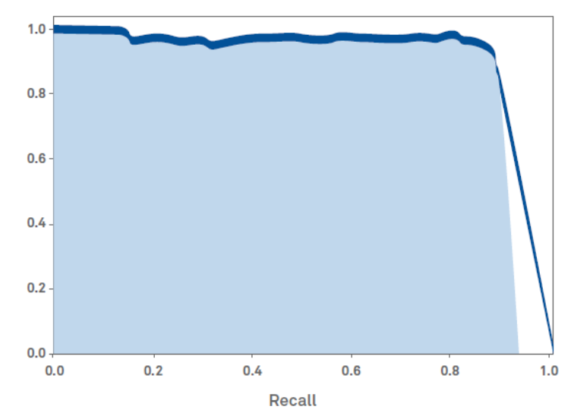
Loss Function
During training, the model is optimized using a combination of localization loss, confidence loss, and classification loss. The goal is to minimize the difference between the predicted values and the ground truth.
Precision

Slide 27
Conclusion
ResNet-50: Commonly used for image classification tasks but not specifically designed for object detection. Fine-tuning for object detection may involve adding detection-specific layers. YOLOv8: Designed for real-time object detection. End-to-end training for object detection, which simplifies the training process. Precision and Recall: ResNet-50: Primarily used for image classification, where precision and recall are not the main evaluation metrics. Can be adapted for object detection tasks but might not perform as well as architectures designed specifically for detection. YOLOv8: Optimized for object detection tasks. YOLOv8 often achieves good precision and recall, especially with proper training and fine-tuning

Slide 28
REFERENCES
[4] O. Russakovsky, J. Deng, H. Su, J. Krause, S. Satheesh, S. Ma, Z. Huang,
A. Karpathy, A. Khosla, M. Bernstein, A.C. Berg, L.I. Fei-Fei, Imagenet large scale
visual recognition challenge, Int. J. Comput. Vis. 115 (3) (2015) 211–252.
[5] F. Liu, J. Liu, L. Wang, Deep learning and infrared thermography for asphalt
pavement crack severity classification, Autom. Constr. 140 (2022), 104383.
[6] F. Liu, J. Liu, L. Wang, Asphalt pavement fatigue crack severity classification by
infrared thermography and deep learning, Autom. Constr. 143 (2022), 104575.
[1] L. Zhang, F. Yang, Y. D. Zhang, Y. J. Zhu, Road crack detection using deep convolutional neural network, in: 2016 IEEE international conference on image processing (ICIP), IEEE, 2016, pp. 3708–3712.
[2] N. T. H. Nguyen, T. H. Le, S. Perry, T. T. Nguyen, Pavement crack detection using convolutional neural network, in: Proceedings of the 9th International Symposium on Information and Communication Technology, 2018, pp. 251–256.
[3] B. Li, K.C. Wang, A. Zhang, E. Yang, G. Wang, Automatic classification of pavement crack using deep convolutional neural network, Int. J. Pavement Eng. 21 (4) (2020) 457–463.

Slide 29

THANK YOU

